Slide 1
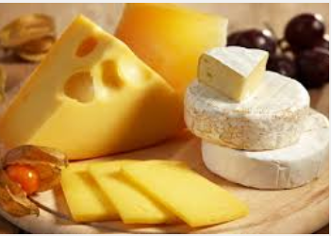
All About Cheese
Te Awamutu College
October 2015

Slide 2
What Are We Going To Cover
Cheese – History and Types
Cheese Making - Chemical Reactions
Milk – Background, Composition

Slide 3
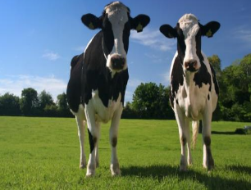
Milk
Milk is produced and drunk worldwide
What do we know about milk
Name four other types of animals that produce milk we drink
Name four types of products made from milk

Slide 4
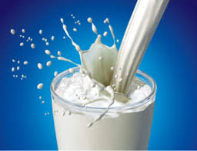
Milk is Fragile
It is “fragile” and has a SHORT SHELF LIFE
Not everyone is able to get fresh milk
So we need to look at ways we can “PRESERVE” it
Why does it have a short shelf life?
What do you think preserving means?
Name 2 ways we can preserve it

Slide 5
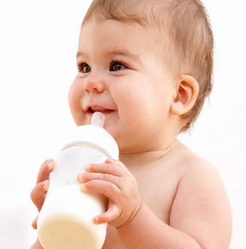
Milk is Nutritious
Main Constituent | Percentage
Water | 87.5%
Fat | 3.9%
Protein | 3.4%
Lactose | 4.8%
Minerals | 0.8%
What is Lactose?

Slide 6
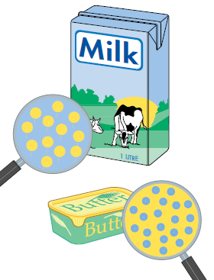
Chemically Milk is an:
EMULSION
A suspension of droplets of one liquid in another
liquid
Milk is an emulsion of fat in water
AND
COLLODIAL SUSPENSION
When something no truly dissolved (in suspension) e.g. chalk in water
Milk proteins are in suspension

Slide 7
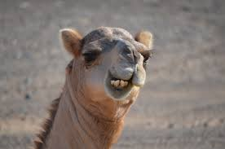
Cheese – History
Cheese has been made in most cultures from ancient times.
Cheese was “invented” almost by accident.
Milk being transported inside an animal skin bag made from a calf stomach solidified
Most likely residual rennet in the stomach lining causing the milk to coagulate
Fermented in the heat of the day to produce a basic fresh (or maybe, no so fresh!) curd.

Slide 8
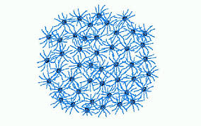
Cheese – What is it
Cheese is concentrated milk
The basic solids of cheese are mainly
Protein (Casein Protein)
Fat
The residual liquid is called whey
Protein (Whey protein)
The casein and fat in the milk are concentrated approx. 10 times in cheese production

Slide 9
Cheese Chemical Reactions
Three important ones when making cheese
Addition of RENNET
Addition of STARTER CULTURE
MATURATION PROCESS

Slide 10
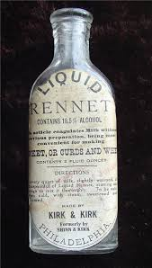
Rennet
It is an ENZYME that breaks down the protein in milk
The enzyme is call CHYMOSIN
What is an enzyme?
Protein creates a bio-chemical reaction
It chops off the hydrophilic protein strands
Leaves the hydrophobic part of the casein and
causes coagulation of the CASEIN protein

Slide 11
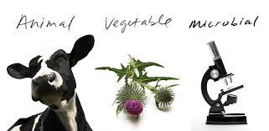
Rennet
Originally from stomachs of young calves
Now chemically made from
Plants
Micro-organisms

Slide 12
How Does the Rennet Work

Slide 13
Milk is a suspension

Slide 14
Proteins in milk made of molecular clusters Micelles

Slide 15
Strands Kappa Casein – are hydrophilic Proteins stay in suspension

Slide 16
Chomysin enzyme chops off the strands Protein becomes hydrophobic and clumps together

Slide 17
The clumping forms a gel –trap the whey and fat

Slide 18
Cutting and stirring - breaks the gel

Slide 19
Heat shrinks the curds - releasing more whey

Slide 20
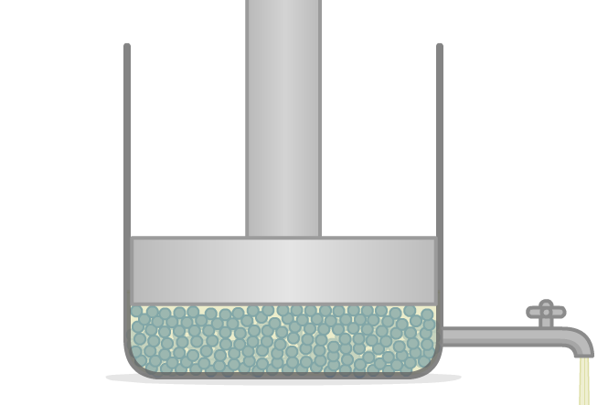
Right texture – drain whey and press

Slide 21
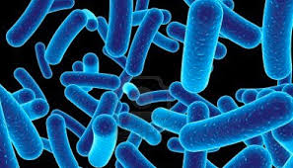
Starter Culture
Specific bacteria used for cheese making
Develop acid in the cheese curd for milk preservation– Lactic Acid
“Feed off the lactose in the milk”
Protect against other micro organisms
Provide enzymes to allow flavor development to occur during maturation
Usually use two types
Mesophilic - 20°C to 40°C
Thermophilic - 45°C (Heat loving)

Slide 22
Cheese Types
Name Five Different Types of Cheese

Slide 23
Words and Definitions you should know
Preserve
Short Shelf Life
Emulsion
Collodial Suspension
Casein Protein and Whey Protein
Hydrophilic
Hydrophobic
Enzyme
Coagulation

